Slide 1


Delicate Information Exchange among representative and authority (Network Security) Batch A23
Team Details :
Gayathri S – 211418104062
Hyshwarrya J D – 211418104088
Keerthana P N – 211418104117
Project Guide :
Mrs. D. Jenifer (Asst. prof)

Slide 2

INTRODUCTION
The main aim is to provide a safer environment for sensitive data transactions between the delegate and authority to prevent data leakage if any.
This application provides a distributed application service and uses the blockchain technology to support it.
The SaaS layer module offers a cloud-platform service that allows each party to easily engage in business communications via web portals.
The proposed smart system is used by each party getting involved in the transfer of sensitive data.

Slide 3
LITERATURE SURVEY
Sl.No | TITLE | Year of Publication | Journal Name
1 | A Study on Data Sharing Using Blockchain System and Its Challenges and Applications | 2022 | IGI GLOBAL Publisher of Timely Knowledge
2 | Blockchain-Based System and Methods for Sensitive Data Transactions | 2021 | IEEE Consumer Electronics Magazine
3 | A Survey on Secured Data Sharing using Ciphertext Policy Attribute Based Encryption in Cloud | 2021 | 8th International Conference on Smart Computing and Communications (ICSCC),pp. 170-177
4 | Blockchain based secured information sharing protocol in supply chain management system with key distribution mechanism | 2020 | Journal of Information Security and Applications
5 | Security and Trust in Blockchains: Architecture, Key Technologies, and Open Issues | 2020 | IEEE Transactions on Computational Social Systems, vol. 7, no. 3, pp. 790-801

Slide 4
LITERATURE SURVEY
Sl.No | TITLE | Year of Publication | Journal Name
6 | A Review Paper on DES, AES, RSA Encryption Standards | 2020 | 9th International Conference System Modeling and Advancement in Research Trends (SMART),pp. 333-338
7 | Blockchain-Enabled Information Sharing Within a Supply Chain: A Systematic Literature Review | 2020 | IEEE Access, vol. 8, pp. 49645-49656
8 | A System Architecture of Cybersecurity Information Exchange with Privacy (CYBEX-P) | 2019 | IEEE 9th Annual Computing and Communication Workshop and Conference (CCWC)
9 | Information Encryption Based on the Synthesis of a Neural Network and AES Algorithm | 2019 | 3rd International Conference on Advanced Information and Communications Technologies (AICT), pp. 447-450
10 | Design of password encryption model based on AES algorithm | 2019 | IEEE 1st International Conference on Civil Aviation Safety and Information Technology (ICCASIT), pp. 385-389

Slide 5
PROBLEM STATEMENT
Sensitive data transaction is confidential information that must be kept safe and out of reach from all outsiders unless they have permission to access it.
Access to sensitive data should be limited through sufficient data security and information security practices designed to prevent data leaks and data breaches.
Sensitive data can be any sort of information that needs to be protected from unauthorized access to safeguard the privacy or security of an individual or organization.
It can include any information pertaining to: Passwords.

Slide 6
ADVANCEMENTS
Existing System
Proposed System
Most of the existing homomorphic secret sharing and secure multi-party computing technologies have the problems of massive communication rounds and too much traffic load.
Methodology: Different Hash Function Model, DSA Encryption.
The proposed smart system is used by admin or authority getting involved in the transfer of sensitive data. The final sensitive data is only accessed by the final data administrator or authority person.
Methodology: SHA algorithm, AES Algorithm.

Slide 7
DEVELOPMENT ENVIRONMENT
HARDWARE REQUIREMENTS
SOFTWARE REQUIREMENTS
PROCESSOR : DUAL CORE 2 DUOS
RAM : 2 GB RAM
HARD DISK : 250 GB
FRONT END : HTML, CSS, Js, JQuery
BACK END : JAVA
DATABASE : MYSQL
IDE (S/W Used) : ECLIPSE
OS : WINDOWS 7
TECHNOLOGIES USED: SHA Algorithm, AES Algorithm, Block-chain technology, QR-code

Slide 8
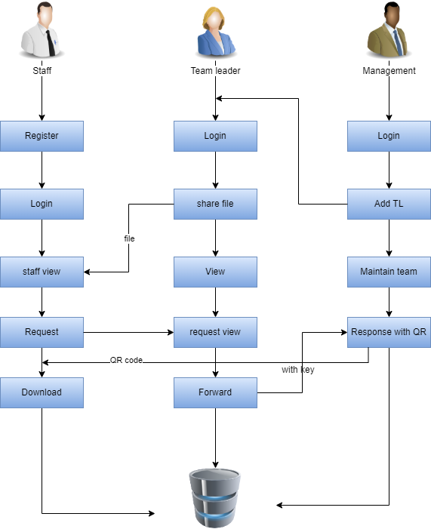
SYSTEM ARCHITECTURE
The systems architect establishes the basic structure of the system, we propose a Hash code Solomon algorithm and we can put a small part of data in local machine and fog server in order to protect the privacy.
Moreover, based on computational intelligence, this algorithm can compute the distribution proportion stored in cloud, fog, and local machine, respectively.
Through the theoretical safety analysis and experimental evaluation, the feasibility of our scheme has been validated, which is really a powerful supplement to existing cloud storage scheme.

Slide 9
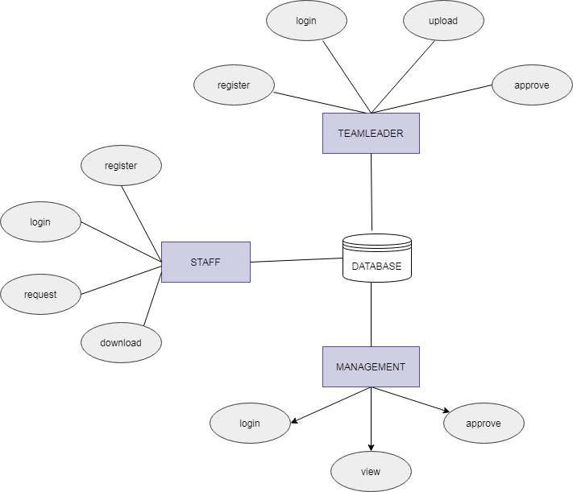
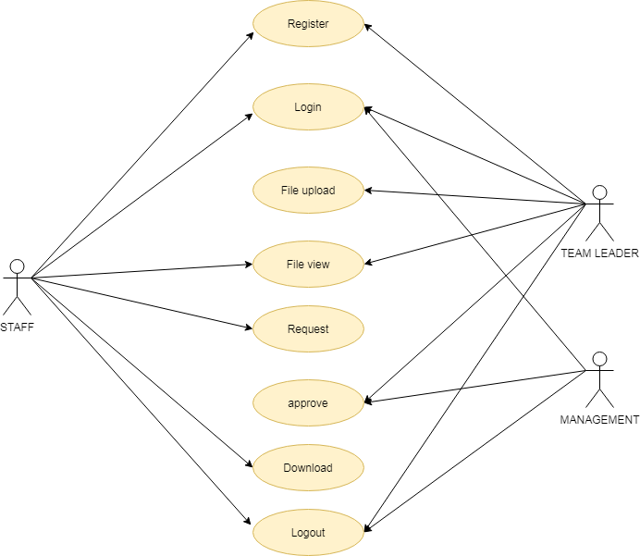
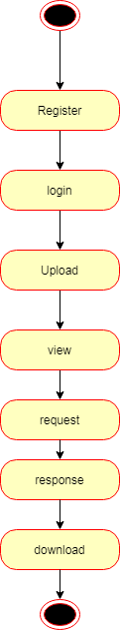
SYSTEM DESIGN
E-R Diagram
Use Case Diagram
State Diagram

Slide 10
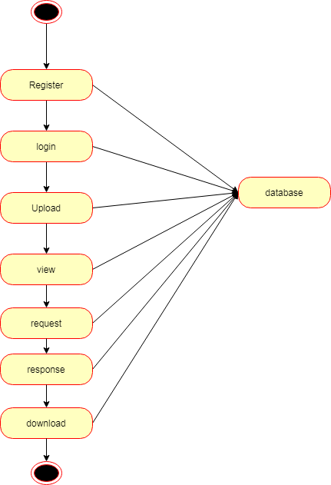
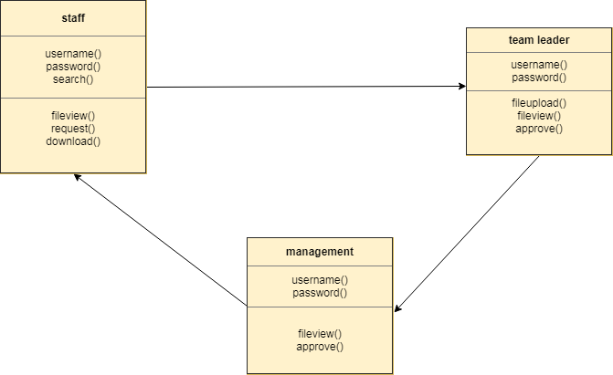
SYSTEM DESIGN
Activity Diagram
Class Diagram

Slide 11
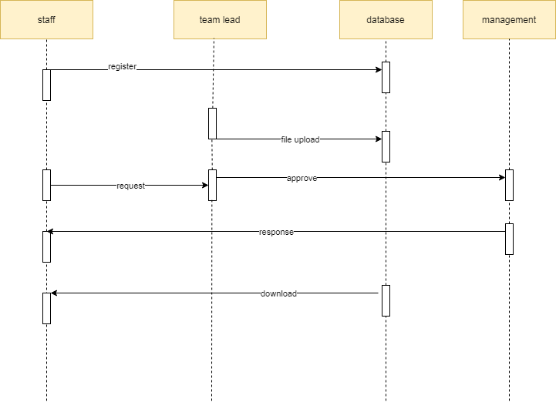
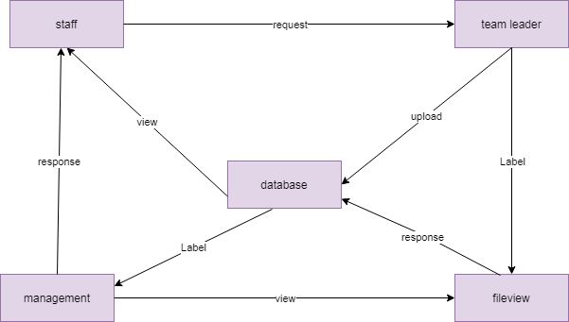
SYSTEM DESIGN
Sequence Diagram
Collaboration Diagram

Slide 12
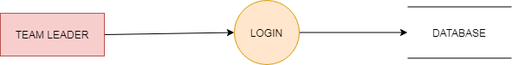
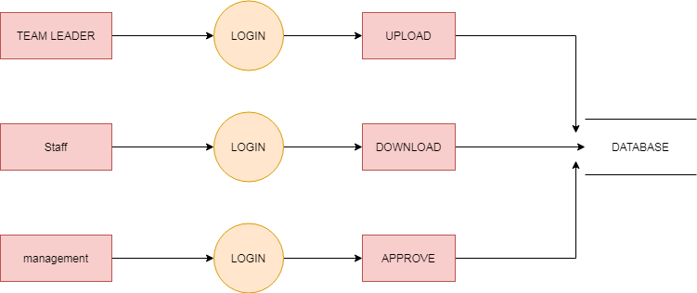
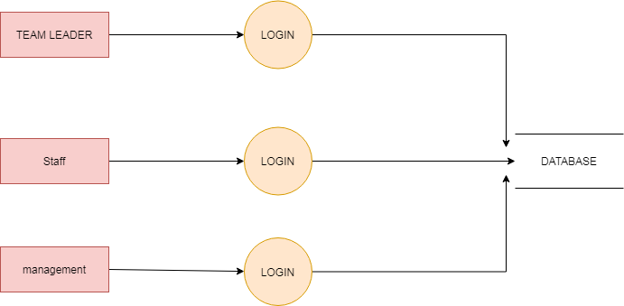
SYSTEM DESIGN
DFD Diagram

Slide 13
MODULE DESCRIPTION
MODULES:
STAFF
TEAM LEADER
FILE ENCRYTION
MANAGEMENT
HASHING AND QR GENERATION
PERMISSION GRANT & APPROVAL
PERMISSION GRANT AND APPROVAL MODULE
MANAGEMENT GENERATE KEY:
In this module the management generate key for the staff request. Because the key for the security purpose. After get the key from management the staff will download the file with key.
MANAGEMENT RESPONSE:
In this module the bank will response the data file fully analyzed data in category wise view Bank will be responsible for your file stored in database.

Slide 14
MODULE DESCRIPTION
STAFF MODULE
STAFF REGISTER:
The register module provides a conceptual framework for entering data on those staff in a way that: eases data entry & accuracy by matching the staff entry to the data source (usually paper files created at point of care), ties easily back to individual staff records to connect registers to staff data, and collects data elements to enable better supervision of donation programs.
STAFF LOGIN:
In this module in our project, here symbolizes a unit of work performed within a database management system (or similar system) against a database, and treated in a coherent and reliable way independent of other transactions. A transaction generally represents any change in database user will transfer the amount to provider.
STAFF FILE VIEW:
In this module the staff will also view the team leader added file. And analysis the details will be responsible for your file stored in database.
STAFF FILE REQUEST:
In this module is used to help to the staff to Request for download file with the land longitude and the user will update the report along with their opinion and the will be stored the database.
STAFF FILE DOWNLOAD:
In this module the staff download the file after management accept the request. It will be stored on local storage.

Slide 15
MODULE DESCRIPTION
TEAM LEADER MODULE
TEAM LEADER LOGIN:
In this module in our project, here symbolizes a unit of work performed within a database management system (or similar system) against a database, and treated in a coherent and reliable way independent of other transactions. A transaction generally represents any change in database user will transfer the amount to provider.
TEAM LEADER FILE UPLOAD:
The team leader can then select a file from their computer and click the Upload button to submit the file to the server. The Java file upload Servlet will then capture that file and persist. It will be stored in database.
TEAM LEADER FILE VIEW:
This module to help us the staff add the file to the staffs. The data directly stored in database. Then staff will view the uploaded file.
MANAGEMENT MODULE
MANAGEMENT LOGIN:
In this module in our project, here symbolizes a unit of work performed within a database management system (or similar system) against a database, and treated in a coherent and reliable way independent of other transactions. A transaction generally represents any change in database user will transfer the amount to provider.
MANAGEMENT TEAM LEADER AND MEMBER REGISTRATION:
The register module provides a conceptual framework for entering data on those team leader in a way that: eases data entry & accuracy by matching the team leader entry to the data source (usually paper files created at point of care), ties easily back to individual team leader records to connect registers to team leader data, and collects data elements to enable better supervision of team programs.

Slide 16
MODULE DESCRIPTION
HASHING AND QR GENERATION MODULE
Hashing is designed to solve the problem of needing to efficiently find or store an item in a collection.
Note: SHA algorithm is used here to generate hash code while a request is given to find a particular file from a database. Since the permission request differs from one staff to another , different hash codes are generated making the access grant integrated
QR code generation happens when the user wants the approval for access of a file by management.
QR code generation is done using Jquery.
The Team leader key along with the QR is used to decrypt the file for the Staff to view it.
Blockchain : It is used in access request and grant permission for validating and tracing the details of the requested person (decryption).
FILE ENCRYPTION MODULE
The file to be accessed by the staff is encrypted using AES algorithm.
The file access permission is requested by the staff member.
The partial decryption of the file happens only when the team leader gives the access key.

Slide 17
ALGORITHMS
SHA Algorithm
AES Algorithm
In the field of cryptography and crypt analytics, the SHA-1 algorithm is a crypt-formatted hash function that is used to take a smaller input and produces a string that is 160 bits, also known as 20-byte hash value long. The hash value therefore generated, is known as a message digest which is typically rendered and produced as a hexadecimal number which is specifically 40 digits long.
The AES Encryption algorithm (also known as the Rijndael algorithm) is a symmetric block cipher algorithm with a block/chunk size of 128 bits. It converts these individual blocks using keys of 128, 192, and 256 bits. Once it encrypts these blocks, it joins them together to form the ciphertext

Slide 18
TESTING/RESULTS
TESTCASE | TESTCASE NAME | EXPECTED OUTPUT | ACTUAL OUTPUT | RESULT (Pass/ Fail)
TC01 | Team Leader new registration | Team Leader added to database | New member added to database | Pass
TC02 | New document upload | Document added to database (encrypted) | Employee can view document added to database | Pass
TC03 | File decryption | Access Keys generation | File decrypted and downloaded | Pass

Slide 19


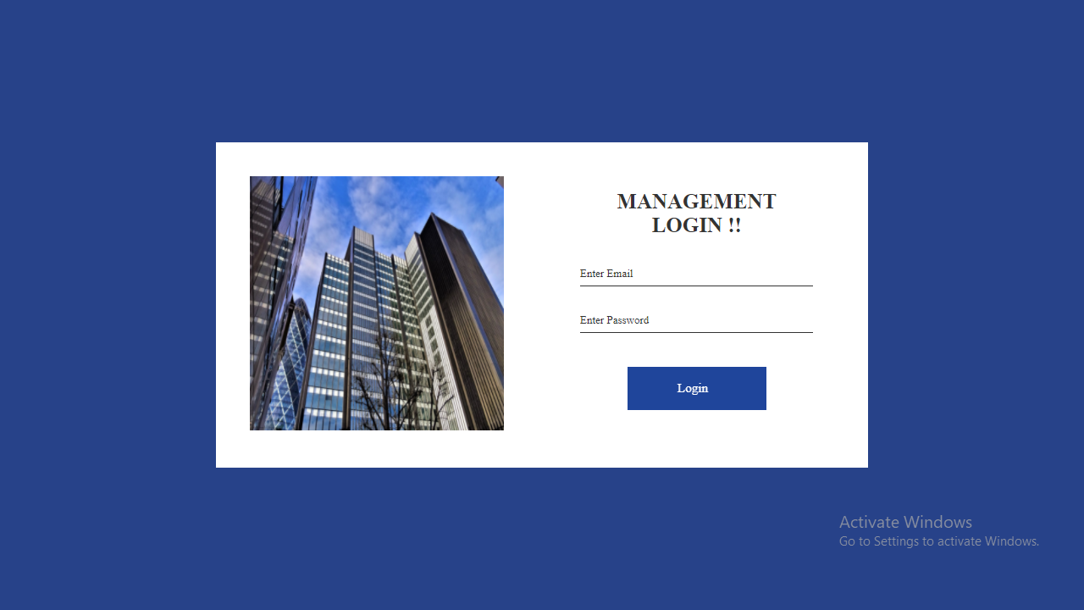
SCREENSHOTS

Slide 20

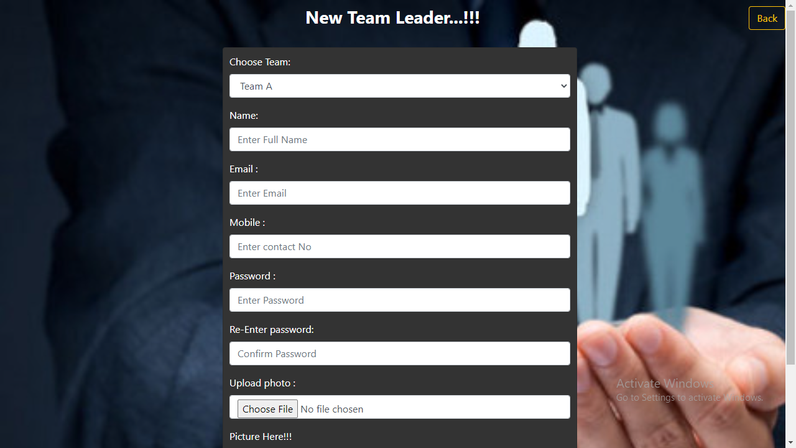
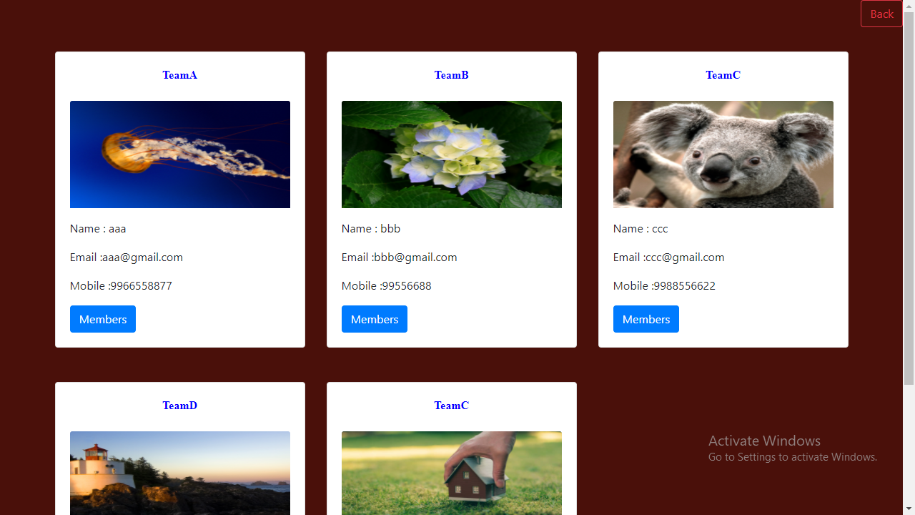
SCREENSHOTS

Slide 21
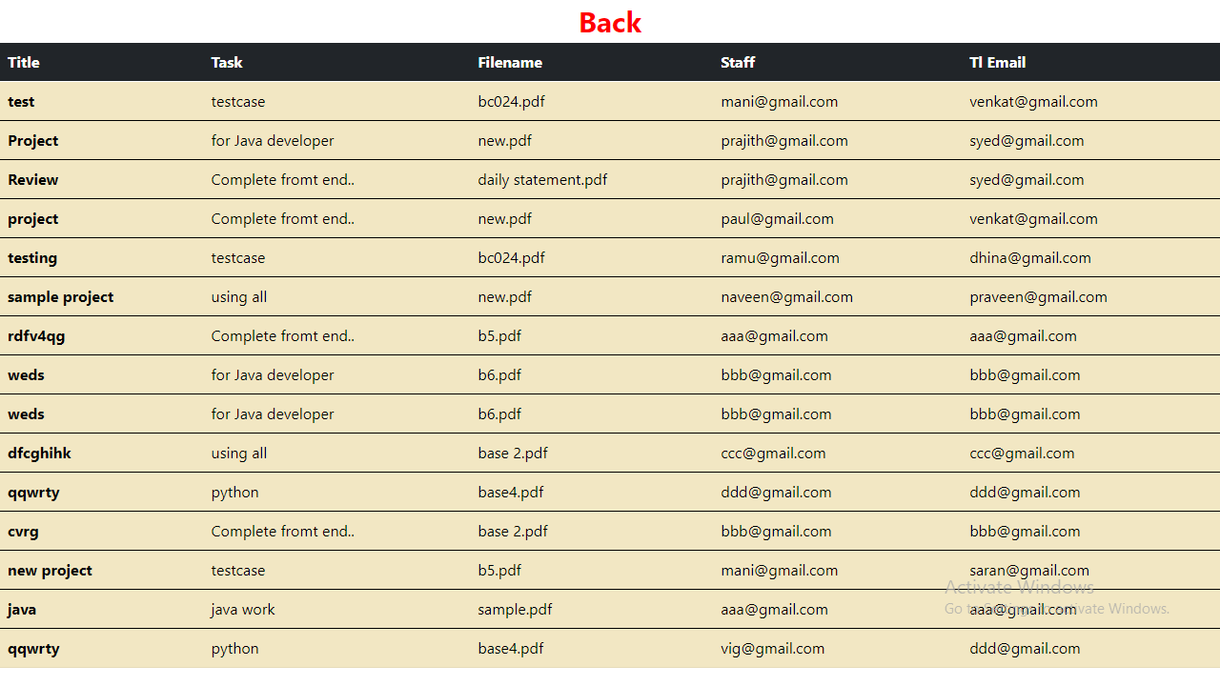

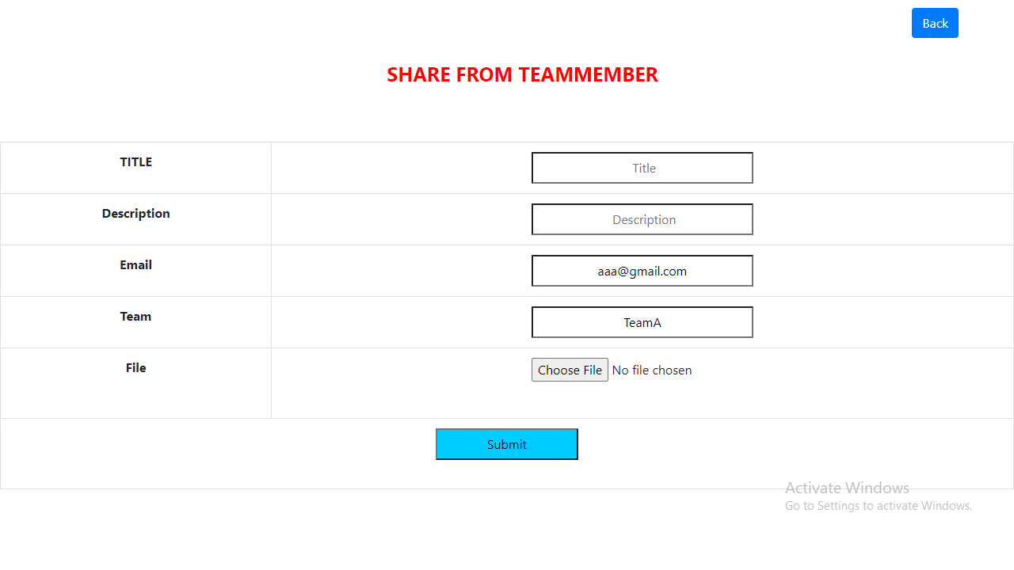
SCREENSHOTS

Slide 22
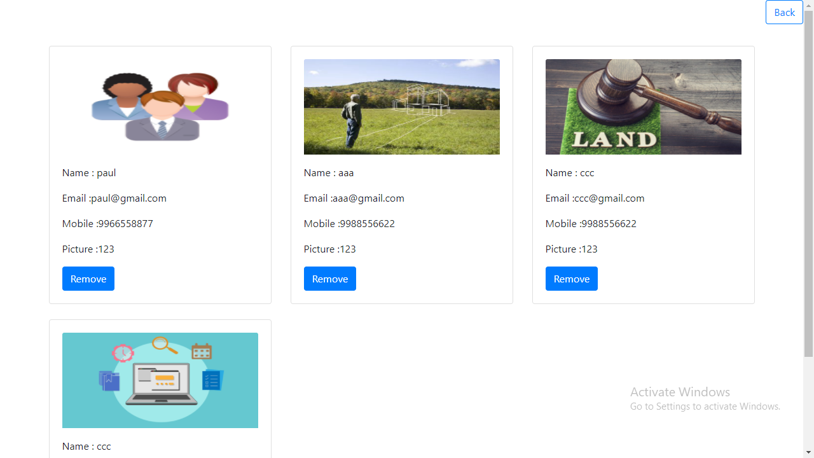
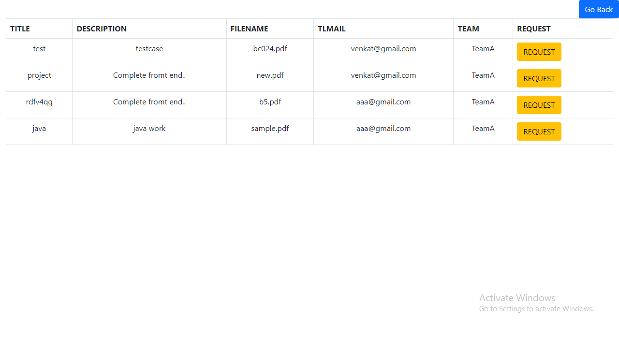

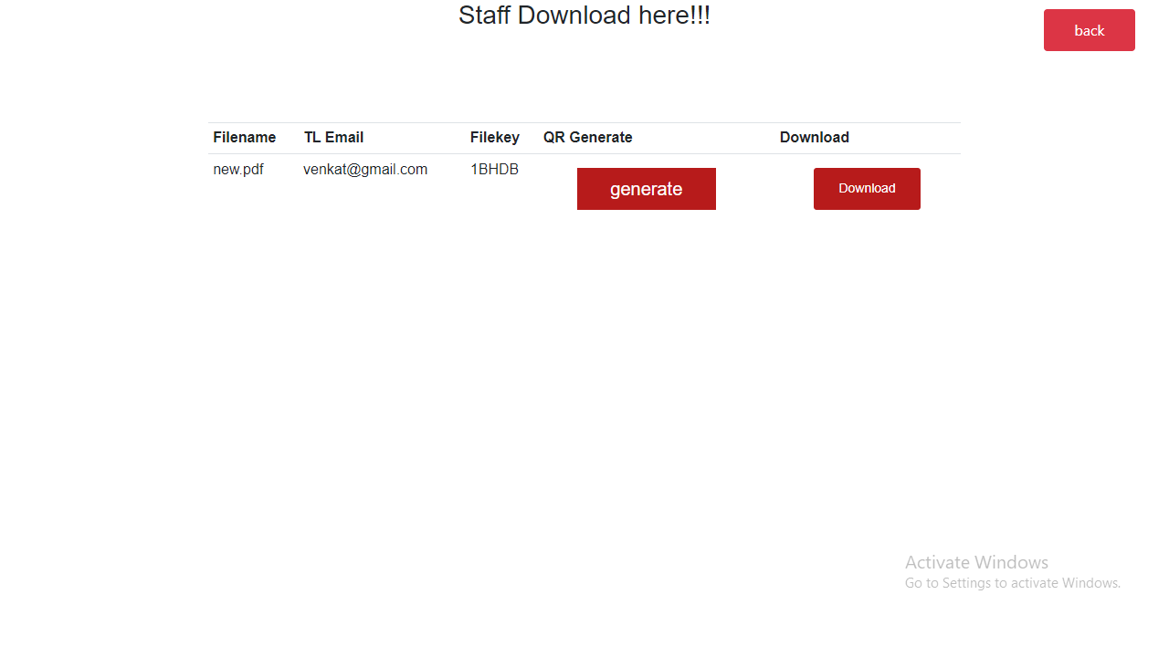
SCREENSHOTS

Slide 23
CONCLUSION
Data sensitivity concerns information that should be protected from unauthorized access or disclosure due to its sensitive nature. For some, that might be Team leader, Staff details records. Sensitive data is confidential information that must be kept safe and out of reach from all outsiders unless they have permission to access it. Access to sensitive data should be limited through sufficient data security and information security practices designed to prevent.
FUTURE ENHANCEMENTS:
Implementing a real-world anonymous database system.
Improving the efficiency of protocols, in terms of number of messages exchanged and in terms of their sizes, as well.
Implement using two algorithms.

Slide 24
REFERENCES
[1] P. J. Taylor, T. Dargahi, A. Dehghantanha, R. M. Parizi, and K. K. R. Choo, “A systematic literature review of blockchain cyber security,” Digital Communications and Networks, vol. 6, no. 2, pp. 147-156, 2020.
[2] D. Liu and J. Lee, “CNN based Malicious Website Detection by Invalidating Multiple Web Spams,” IEEE Access, vol. 8, no. 1, pp. 97258-97266, 2020.
[3] W. Martin, V. Friedhelm, and K. Axel, “Tracing manufacturing processes using blockchain-based token compositions,” Digital Communications and Networks, vol. 6, no 2, pp. 167-176, 2019.
[4] D. Puthal, N. Malik, S. P. Mohanty, E. Kougianos and G. Das, “Everything You Wanted to Know About the Blockchain: Its Promise, Components, Processes, and Problems,” IEEE Consumer Electronics Magazine, vol. 7, no. 4, pp. 6-14, 2018.
[5] L. Peng, W. Feng, and Z. Yan. (2020). Privacy preservation in permissionless blockchain: A survey. Digital Communications and Networks. [Online]. Available: https://doi.org/10.1016/j.dcan.2020.05.008.

